Slide 1
GOSA Grant: “Growing Readers”

Slide 2
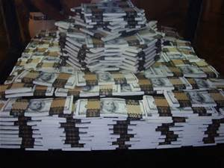
2 million dollars

Slide 3
This grant is focusing on K-3 Foundational Skills: Why?
“Right now, only 34% of Georgia's third graders are reading proficiently by the end of the school year. This means 2 out of every 3 third graders cannot read proficiently in Georgia. Why does this matter? Because third grade is when children make the shift from learning to read to reading to learn.”
Source:
www.getgeorgiareading.org

Slide 4
Language Nutrition
2. Access
3. Learning Climate
4. Teacher Preparedness/Effectiveness

Slide 5
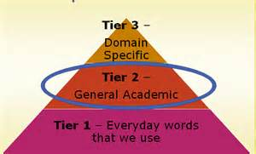
Pillar One: Language Nutrition

Slide 6
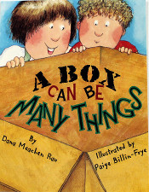
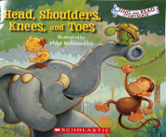
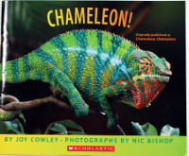
Pillar 2: Access
Be on the LOOKout!
Pre-Kindergarten and Kindergarten Teachers should
have received books during the week of August 17-21, 2015, to give to your students. They can use these books for instruction before sending them home with their students.
.
(GaDOE and www.getgeorgiareading.org )

Slide 7
1000 Books Before Kindergarten
www.readingrockets.org
Reading tips for Parents in
11 Languages

Slide 8
http://www.imaginationlibrary.com/
If you can’t register online download a form and mail it in. Free book a month from birth to five years old.

Slide 10
Pillar 3: Productive Learning Climate Pillar 4: Teacher Preparedness/Effectiveness FIP Modules

Slide 11
Bottom line….
The Heart of Reading

Slide 12
Goal: “Growing Readers”

Slide 13
Tier 1, Tier 2, Tier 3

Slide 14
Pillar 4: Teacher Preparedness/Effectiveness Selection process
Three schools
One vertical team in each school comprised of:
K, 1st, 2nd and 3rd grade teacher
Principal/Assistant Principal
Instructional Coach

Slide 15
Orientation

Slide 16
A few of the GOSA Grant Requirements
Resource Audits need to be done by administration and teachers
Baseline observations by RESA of entire Reading block for each participating teacher
Observations #2, #3, and #4 are “targeted” based on PL
Six days of Professional Offsite Professional Learning for administration and teachers
Baseline, mid, and end of year data shared with GOSA

Slide 17
A few more GOSA grant requirements
Teachers will implement “Best Practices” shared in PL and use assessment to meet needs of students through differentiated instruction
RESA will serve as a “coach” make a minimum of one visit a month to each participating school
RESA will complete monthly status reports for GOSA
16 RESAs will participate in a total of 8 days off site training so that there will be fidelity of PL delivery across the state

Slide 18
Alignment to Current Practice
Standard 7
The teacher provides a well-managed, safe, and orderly environment that is conducive to learning and encourages respect for all.
TAPS Indicators
Promotes a climate of trust and teamwork within the classroom.
Arranges the classroom materials and resources to facilitate group and individual activities.
Observable Behaviors
Teacher promotes student-to-student and student-to-teacher discussion of selections, strategies, vocabulary, and other elements.
Student work is displayed and student successes are celebrated.
Students have individual sets of materials and texts.
Teacher provides adequate space and furnishings for small group work.

Slide 19
Alignment to Current Practice
Standard 3
The teacher promotes student learning by using research-based instructional strategies relevant to the content to engage students in active learning and to facilitate the students’ acquisition of key knowledge and skills.
TAPS Indicators
Develops higher-order thinking through questioning and problem-solving activities.
Uses a variety of research-based instructional strategies and resources.
Observable Behaviors
Teacher asks text-dependent questions.
Teacher asks inferential questions.
Teacher introduces critical vocabulary in a meaningful way.
Teacher models instructional tasks when appropriate.

Slide 20
Golden Nuggets: Alignment to CCRPI
“Initiative” points for participating schools
Vertical K-3 Teams proactively working to raise Lexile scores of third graders to 650 by the end of third grade

Slide 21
Let’s Sum It Up…
Increase the number of “model classrooms” that are effectively
using “evidence based practices”.
2. Provide a “model” so that other teachers can replicate
“best practices” .
3. Increase the number of students who are proficient readers by the
end of third grade.
4. Increase reading proficiency for Tier 2 and Tier 3 students.

