Slide 1
School Climate
What is it?
Who cares?
How is it measured?
What is the link to PBIS?

Slide 2
What is school climate exactly?
Notes:
Think about places we feel safe or connected….
Childhood moments when we felt safe (or unsafe) in school
When we felt particularly connected to a caring adult (or very alone) in school
When we felt very engaged in meaningful learning (or not)…
Places we feel comfortable or uncomfortable—shopping—sporting events—traveling--

Slide 3
“School Climate refers to the quality and character of school life.”
~National School Climate Center

Slide 4
Positive School Climate
Norms, values and expectations that support people feeling socially, emotionally and physically safe.
People are engaged and respected.
Students, families and educators work together to develop, live and contribute to a shared school vision.
Educators model and nurture attitudes that emphasize the benefits and satisfaction gained from learning.
Each person contributes to the operations of the school and the care of the physical environment.
Notes:
Described by the National School Climate Center, these characteristics create a sustainable, positive school climate that fosters youth development and learning necessary for a productive, contributing and satisfying life in a democratic society.

Slide 5
Positive School Climate
Increased academic achievement
Increased student engagement in school
Positive social skills development
Notes:
Research has demonstrated…..

Slide 6
Four Dimensions of School Climate
Safety: referring to the physical and emotional safety of students and the rules and procedures in place to ensure student safety;
Relationships / Engagement: student social support from educators and parents, the level of respect students have for others, school and community engaged, and student and parental leadership;
Teaching and Learning: a positive and professional student-teacher-school relationship, social and emotional skills training, civic education, and positive support for learning; and
Institutional Environment: the physical environment of the school.
Notes:
There is not a national consensus about what school climate dimensions should be assessed.
The National School Climate Center has defined four main areas for measuring school climate.
Georgia is following the guidelines suggested by the National School Climate Center.

Slide 7
Who cares, really?

Slide 8
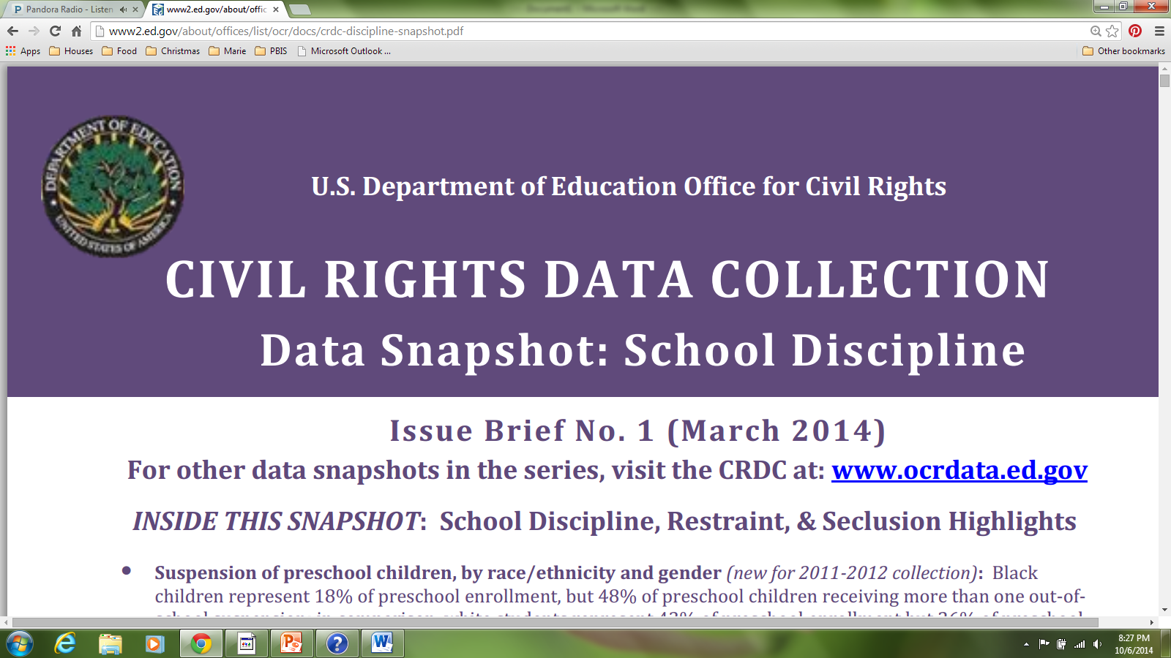
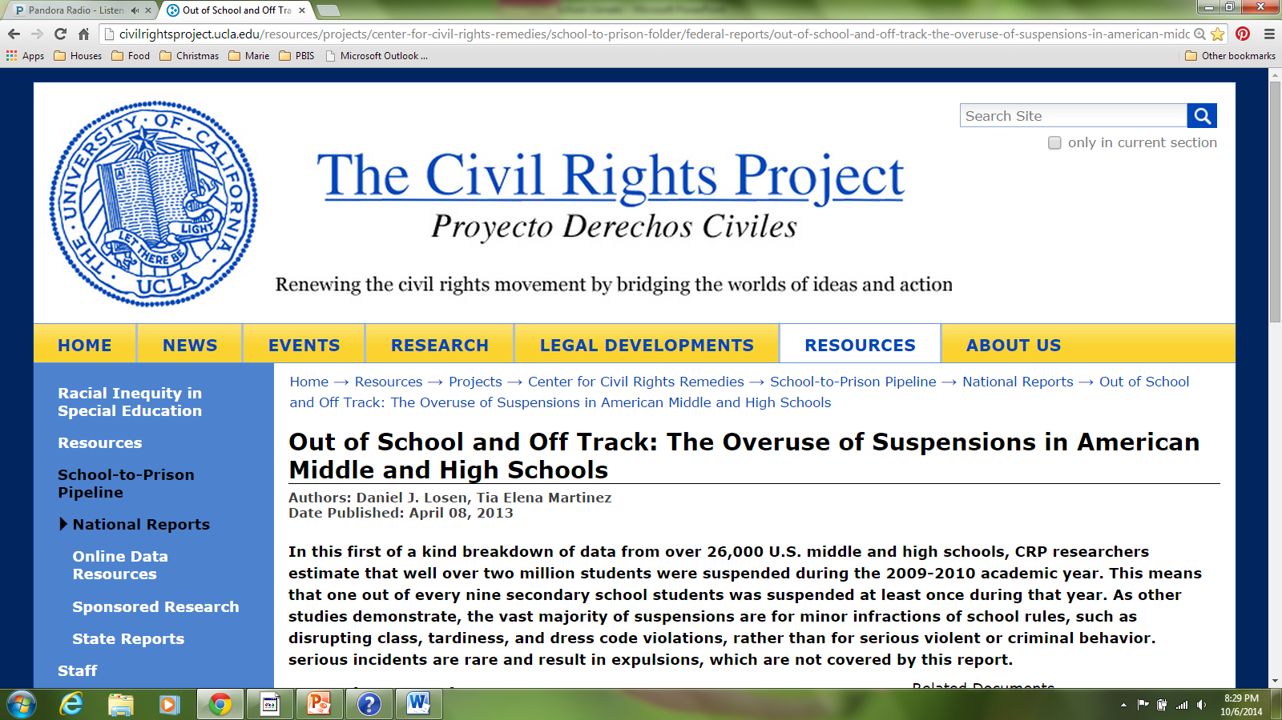
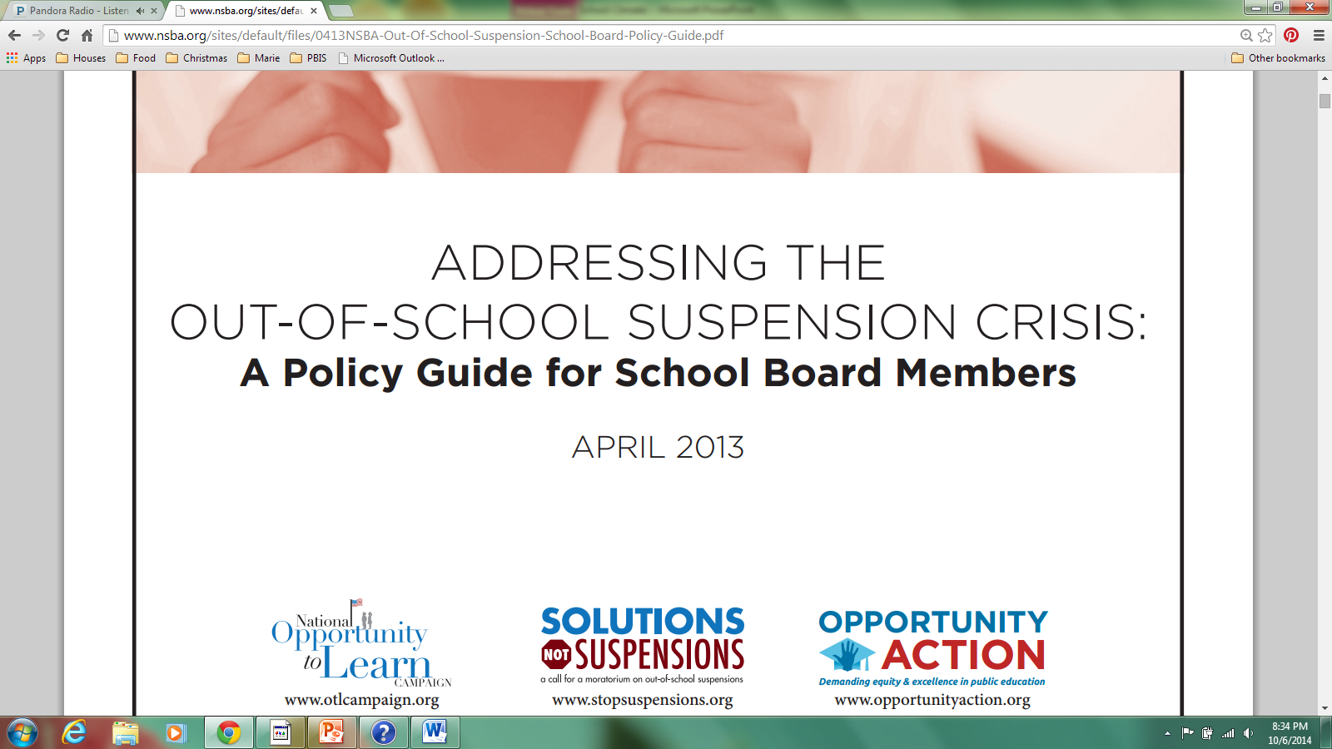
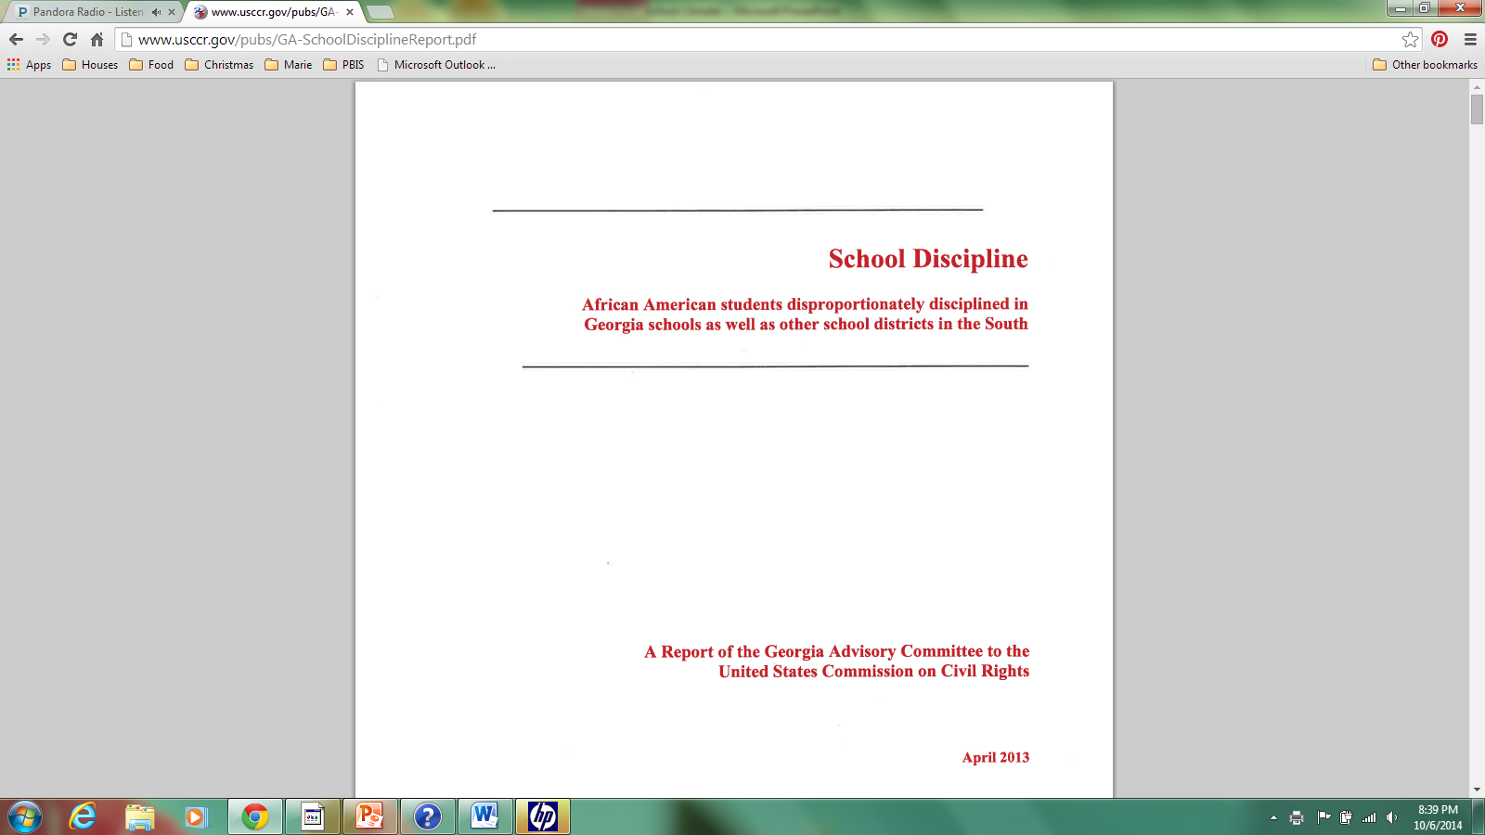
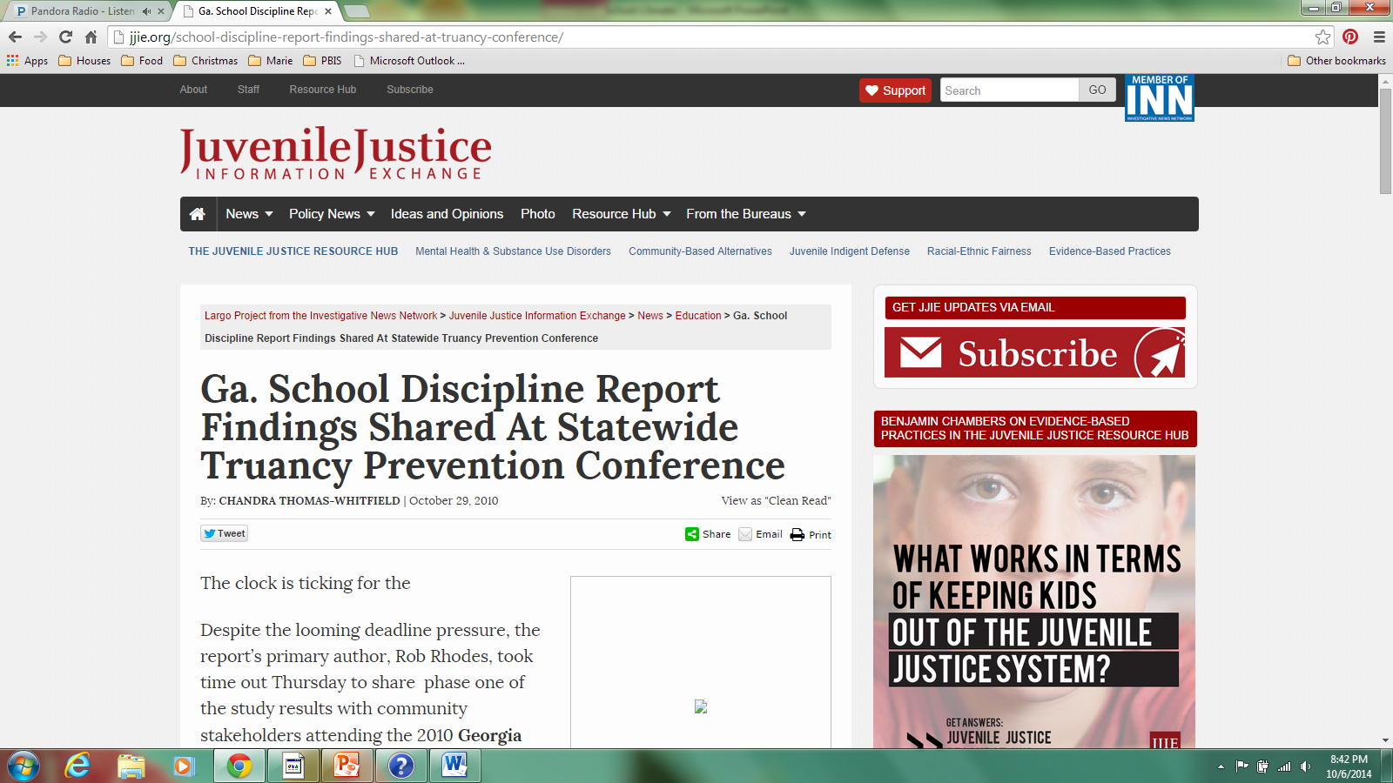
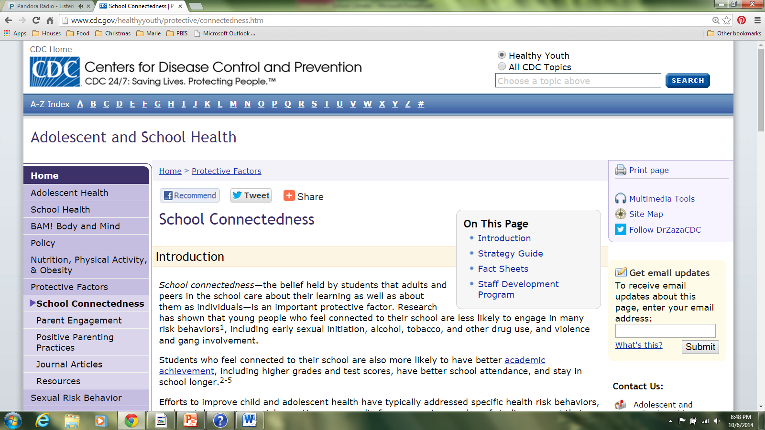
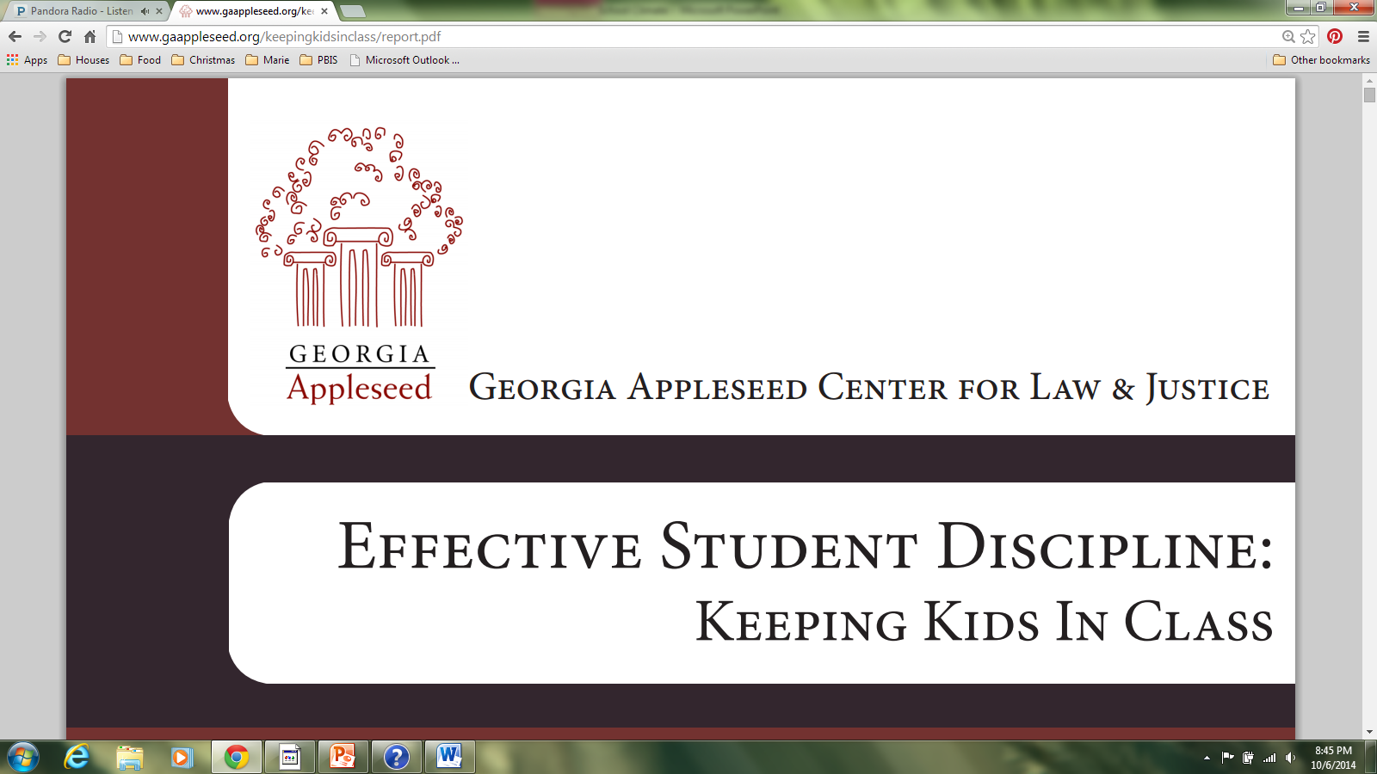
Notes:
If you Google “school climate,” “suspension,” “school attendance,” or “school connectedness,” these websites will show up:
U.S. Dept. of Ed. Office of Civil Rights
UCLA’s Civil Rights Project
National School Boards Association
United States Commission on Civil Rights
Juvenile Justice Information Exchange
Georgia Appleseed Center for Law & Justice
Centers for Disease Control and Prevention
National School Climate Center
The Council of State Governments Justice Center
And many, many others….
THEY are looking at your data. Are YOU aware of your data? What is your response?

Slide 9
Who is tracking YOUR data?
http://ocrdata.ed.gov
www.gaappleseed.org/toolkit/
www.schooldisciplinedata.org

Slide 10
U.S. Department of Education
Dear Colleague guidance letter on School Climate and Discipline
January 8, 2014
Notes:
Letter and resources provided to “describe how schools can meet their obligations under federal law to administer student discipline without discriminating on the basis of race, color, or national origin.”

Slide 11
Disproportionality
Students of color and students with disabilities are disproportionately impacted by suspensions and expulsions.
African-American students without disabilities are more than three times as likely as their white peers without disabilities to be suspended or expelled.
One study found that 95% of out-of-school suspensions were for nonviolent, minor disruptions such as tardiness or disrespect.

Slide 12
Source: U.S. Dept. of Education’s Civil Rights Data Collection: Data Snapshot

Slide 13
Source: U.S. Dept. of Education’s Civil Rights Data Collection: Data Snapshot

Slide 14
Costs of Suspension/Expulsion
Often unsupervised
Fail to benefit from great teaching
Fail to receive positive peer interactions and adult mentorship offered in schools
Often fail to develop the skills and strategies needed to improve their behavior to avoid future problems
Less likely to graduate on time
More likely to be suspended again
More likely to repeat a grade
More likely to drop out
More likely to become involved in the juvenile justice system

Slide 15
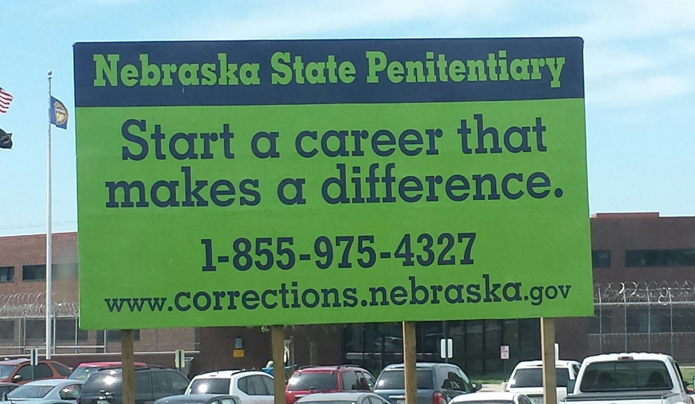
Notes:
Probably not the career track that we are working toward!

Slide 16
Called to Reexamine School Discipline
Take deliberate steps to create positive school climates that can help prevent and change inappropriate behaviors.
Ensure that clear, appropriate, and consistent expectations and consequences are in place to prevent and address misbehavior.
Understand civil rights obligations and strive to ensure fairness and equity for all students by evaluating the impact of discipline policies and practices by analyzing data.
Notes:
Within the U.S. Dept. of Ed.’s guidance, each of the principles has suggested action-steps.
The first expectation in the recommendations is to “take deliberate steps to create positive school climates.”

Slide 17
Where do we Stand?

Slide 18
CSRA Data: OSS
Notes:
Data compiled from the Georgia Appleseed Toolkit. Percentage represents the number of students who have had at least one out-of-school suspension during a school year.
Most recent data is 2013, but if you look at the trend data for your system, there is little reason to think that it has changed.

Slide 19
CSRA Data: Attendance
Notes:
This is system data for students with more than 15 days absent.
If you look at data for your high schools and middle schools, the absentee rates are much higher.
Students who feel connected to school tend to have lower absences. (Common sense!)

Slide 20
Take a moment to look at your data.
Notes:
Individual school data provided in folders, along with identification of system numbers for system comparisons.

Slide 21
Measuring School Climate in Georgia
CCRPI:
College and Career Ready Performance Index
Notes:
But, even if it were not being measured, wouldn’t it make sense to make changes to improve school climate?

Slide 22
CCRPI
Notes:
We hear the ratings will be released in December. The DOE was waiting to clear up discrepancies in data reporting.

Slide 23
Measuring School Climate in Georgia
Georgia Student Health Survey II (GSHS II)
Administered annually to students in grades 6-12
Grades 3-5 added in school year 2013-2014
Georgia School Personnel Survey (GSPS)
Administered annually to teachers, staff and administrators
Georgia Parent Survey
Administered annually to parents online
School Climate Star Rating
Part of Georgia’s new accountability system – College and Career Ready Performance Index (CCRPI)

Slide 24
School Climate Star Rating 1-5
School Climate
(GSHS II, GSPS, Parent Survey)
Safe and Substance-Free Learning Environment
Student Discipline
Schoolwide Attendance
Notes:
4 components!
School Climate: Survey results, 75% participation required for students and teachers, variance between surveys will be utilized
Safe and Substance-Free Learning Environment: % non-violent discipline incidents, % non-drug/alcohol related incidents, % not abusing substances (survey data), % not experiencing bullying/harassment (survey data)
Student Discipline: Weighted suspension rates for ISS, OSS, and alt. school assignments will be included
School Attendance: ADA of students, teachers, administrators, and staff; individuals with 30+ absences will be removed from calculations

Slide 25
Additional Considerations
Unsafe School Choice Option (USCO)
“Persistently Dangerous Schools” will lose two stars on School Climate Star Rating.
Schools with felony USCO incidents (i.e. Aggravated Battery, Armed Robbery, Rape, etc.) will lose one star.
Disciplinary Disproportionality
Schools will lose one star for disciplinary disproportionality.
Suspension risk includes: OSS, Expulsion, and Assignment to Alternative Schools
Program Services examine the risk of being suspended between Students with Disabilities (SWD), English Language Learner (ELL), and Economically Disadvantaged compared to their non-service reference group.
Race/Ethnicity examines the risk each subgroup compared to all other students.
Need two (2) consecutive years per subgroup for disproportionality “penalty”

Slide 26
Additional Considerations
Research/Evidence-based Programs/Practices
Schools can earn up to five additional points on their School Climate Star Rating if they are implementing an evidence/research-based program or practice with fidelity.
Example includes but is not limited to Positive Behavioral Interventions and Supports (PBIS).
Notes:
This year, schools will earn an extra half point for implementing PBIS at the “operational” or “emergent” level as determined by the End-of-Year data submitted to the DOE by implementing schools.

Slide 27
Positive Behavior Interventions & Supports
PBIS

Slide 28
More PBIS Info…
http://www.pbis.org/
http://www.gadoe.org/Curriculum-Instruction-and-Assessment/Special-Education-Services/Pages/Positive-Behavioral-Interventions-and-Support.aspx

Slide 29
PBIS = Framework
Reduce disciplinary incidents
Increase sense of safety
Improve school climate
Support improved academic outcomes for all students

Slide 30
PBIS is not…
A packaged curriculum
A scripted intervention
A manualized strategy

Slide 31
Traditional Discipline vs. PBIS
Traditional (reactive)
PBIS (proactive)
Reactive/consequence strategies
Expansion of zero-tolerance policies
Restrictive and segregated settings
Funding more School Safety Officers
Installing more security cameras
Self-defense training for educators
Evidence-based/research-based
Changes the environment (adult behavior)
Additional supports for staff and students become “built-in”
All school-wide discipline decisions are data-driven
Team approach to problem solving
Notes:
TRADITIONAL
Reactive, Consequence Strategies
Office referral, detention, suspensions, etc.
Consequences do not teach the “right way”
Consequences my actually reinforce the behavior of concern
PBIS
Changes the environment (adult behavior)
Teaching appropriate skills
Altering environments or practices that contribute to problem
Additional supports for staff and students become “built-in”
Acknowledge appropriate behavior more frequently

Slide 32
Critical Elements of PBIS
PBIS Team-Administrative Support
Clear Expectations & Rules
Lesson Plans for Teaching Behavior
Data Entry & Analysis
Acknowledgement/Recognition Program (Feedback)
Effective Discipline Process
Faculty Commitment, Participation
Implementation Planning
Classroom PBIS Systems
Evaluation

Slide 33
Experimental Research on SWPBIS
Bradshaw, C.P., Koth, C.W., Thornton, L.A., & Leaf, P.J. (2009). Altering school climate through school-wide Positive Behavioral Interventions and Supports: Findings from a group-randomized effectiveness trial. Prevention Science, 10(2), 100-115
Bradshaw, C.P., Koth, C.W., Bevans, K.B., Ialongo, N., & Leaf, P.J. (2008). The impact of school-wide Positive Behavioral Interventions and Supports (PBIS) on the organizational health of elementary schools. School Psychology Quarterly, 23(4), 462-473.
Bradshaw, C. P., Mitchell, M. M., & Leaf, P. J. (2010). Examining the effects of School-Wide Positive Behavioral Interventions and Supports on student outcomes: Results from a randomized controlled effectiveness trial in elementary schools. Journal of Positive Behavior Interventions, 12, 133-148.
Bradshaw, C.P., Reinke, W. M., Brown, L. D., Bevans, K.B., & Leaf, P.J. (2008). Implementation of school-wide Positive Behavioral Interventions and Supports (PBIS) in elementary schools: Observations from a randomized trial. Education & Treatment of Children, 31, 1-26.
Bradshaw, C., Waasdorp, T., Leaf. P., (in press). Effects of School-wide positive behavioral interventions and supports on child behavior problems and adjustment. Pediatrics.
Horner, R., Sugai, G., Smolkowski, K., Eber, L., Nakasato, J., Todd, A., & Esperanza, J., (2009). A randomized, wait-list controlled effectiveness trial assessing school-wide positive behavior support in elementary schools. Journal of Positive Behavior Interventions, 11, 133-145.
Horner, R. H., Sugai, G., & Anderson, C. M. (2010). Examining the evidence base for school-wide positive behavior support. Focus on Exceptionality, 42(8), 1-14.
Ross, S. W., Endrulat, N. R., & Horner, R. H. (2012). Adult outcomes of school-wide positive behavior support.
Journal of Positive Behavioral Interventions. 14(2) 118-128.
Waasdorp, T., Bradshaw, C., & Leaf , P., (2012) The Impact of Schoolwide Positive Behavioral Interventions and
Supports on Bullying and Peer Rejection: A Randomized Controlled Effectiveness Trial. Archive of
Pediatric Adolescent Medicine. 2012;166(2):149-156
SWPBIS Experimentally Related to:
Reduction in problem behavior
Increased academic performance
Increased attendance
Improved perception of safety
Reduction in bullying behaviors
Improved organizational efficiency
Reduction in staff turnover
Increased perception of teacher efficacy
Improved Social Emotional competence

Slide 34
Importance of Teaching Behavior
Behavior is learned and can be taught.
Students do not learn better ways of behaving when only given aversive consequences.
Students must be directly taught the expected behaviors.
Behavior is maintained by the consequences.
Students must be given specific feedback and opportunities to practice where the behaviors should be used.

Slide 35
School-wide Information System (SWIS) Big 7 Data Collection & Analysis
ODR’s by:
Behavior
Location
Time of Day
Per day per month
Student
Days of the Week
Grade Level
Notes:
35
These are the questions you will want to ask every month in your team meetings.
Use this data to determine what response to take: what to teach, what practice to change, what to reinforce.

Slide 36
PBIS is NOT…
Just a reward system for students.
A commitment to have all schools trained in the first or second years, but a commitment to support those trained over time to ensure fidelity.
A guarantee that training alone will turn your data around….Systems-change must include adult change.
A commitment to a program but a process.

Slide 37
System Requirements for PBIS
Agreement by Superintendent to a multi-year systems change
process by District
Commitment to sustainability:
PBIS District Leadership Team-data analysis at least 2-4 times per year
District PBIS Coordinator
School PBIS Team with School PBIS Coach
Readiness Activities:
Data Review (academic, discipline, attendance, surveys)
Reducing discipline incidents in the top three priorities of district
Develop System Implementation Plan
Implementation Process:
Three-day training/planning with DOE-School Teams including principals
School Wide Information System (SWIS) software must be used by implementing schools for at least one year ($300/yr/school)
including half-day training for admin, coach, and clerk

Slide 38
Reasons NOT to Implement PBIS
Satisfaction with your current data
Unwilling to change policies or procedures
No administrative support for PBIS
Cannot make time for teams to meet regularly
Unwilling to regularly analyze data
Expect students to “know how to behave at school”

Slide 39
How do we respond to the U.S. Dept. of Ed’s expectations?
Take deliberate steps to create positive school climates that can help prevent and change inappropriate behaviors.
Ensure that clear, appropriate, and consistent expectations and consequences are in place to prevent and address misbehavior.
Understand civil rights obligations and strive to ensure fairness and equity for all students by evaluating the impact of discipline policies and practices by analyzing data.
Notes:
PBIS has proven time and again to create positive school climates, prevent and change inappropriate behaviors.
PBIS ensures clear, appropriate, consistent expectations and consequences.
PBIS helps to ensure fairness and equity and has at its foundation the analysis of data.

Slide 40
Resources:
U.S. Dept. of Education Guidance letter: January 8, 2014
“School Climate and the CCRPI” PowerPoint, Georgia DOE, by Marilyn Watson and Jeff Hodges
“School Climate, Positive Interventions & Supports” PowerPoint, SWGA RESA, by Kathy Wooten
Georgia Appleseed Center for Law & Justice (www.gaappleseed.org)
Governor’s Office of Student Achievement (https://gaawards.gosa.ga.gov)
Georgia Department of Education (www.gadoe.org)
National School Climate Center (www.schoolclimate.org)
Positive Behavioral Interventions & Supports (www.pbis.org)
Marie Echols
School Climate Specialist
CSRA RESA
mechols@csraresa.org

